Slide 1
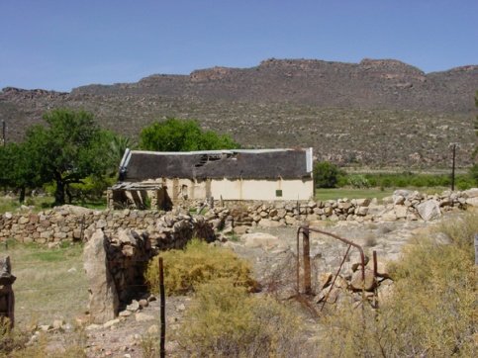
Societies in Conflict
Humans | The Natural World
Shifting Boundaries Between Them
Professor Laura Mitchell
mitchell@uci.edu | 243 Krieger Hall
Office hours: Tuesdays 3.30 - 4.30
& by appointment

Slide 2
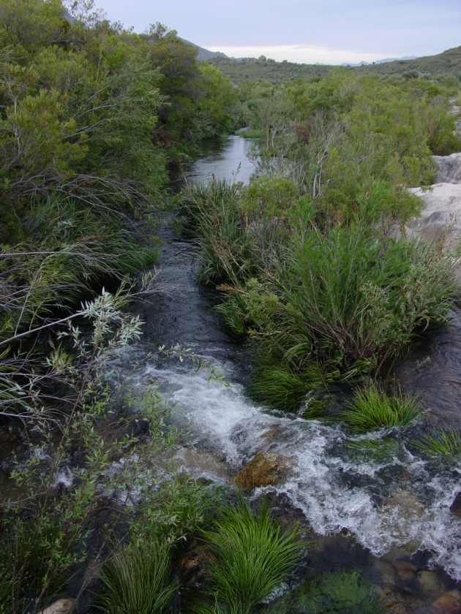
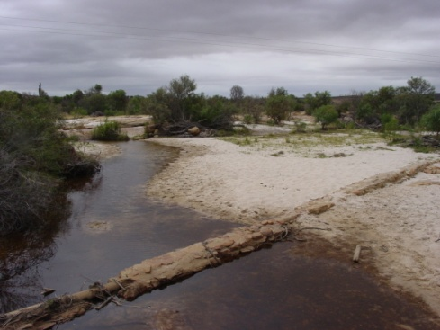
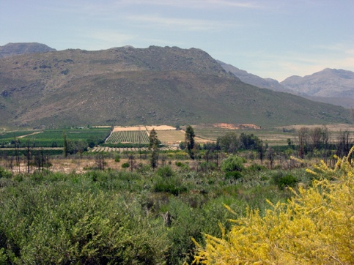
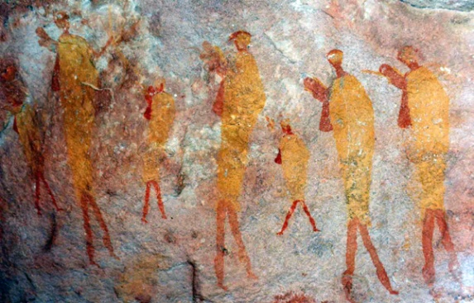
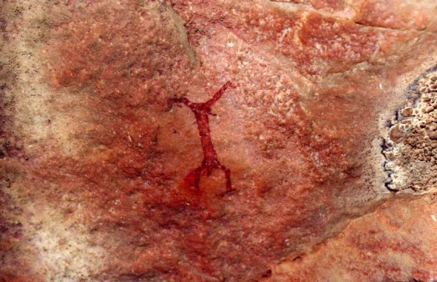
Questions at the center of colonial conflicts:
Who controls the use of natural resources?
What is the proper relationship between humans and the natural world?
What is the nature of humanity?
  In a colonial context, who gets to be human?

Slide 3
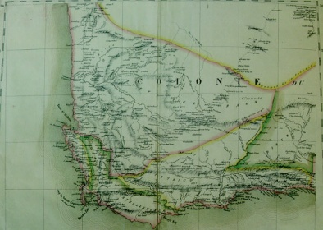
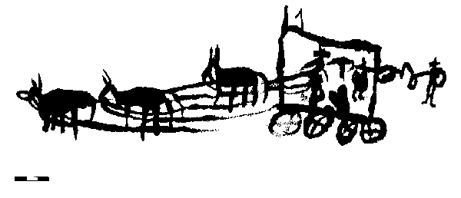
Learning Objectives
Emphasis on historical thinking skills
  Specific learning objectives
Introduction to geographical and cultural landscape of South Africa
Historians’ emphasis on time-place specificity and contingency

Slide 4
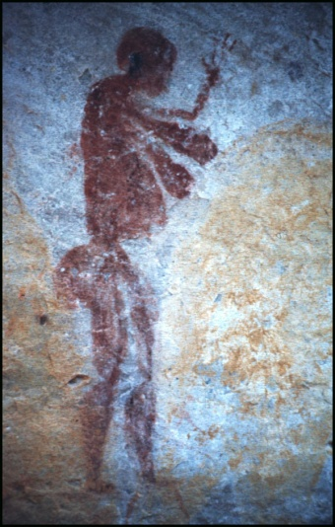
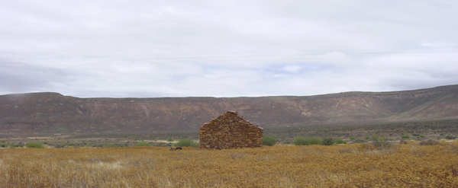
Traces in the Landscape

Slide 5
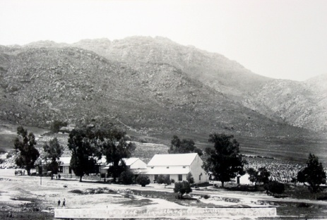
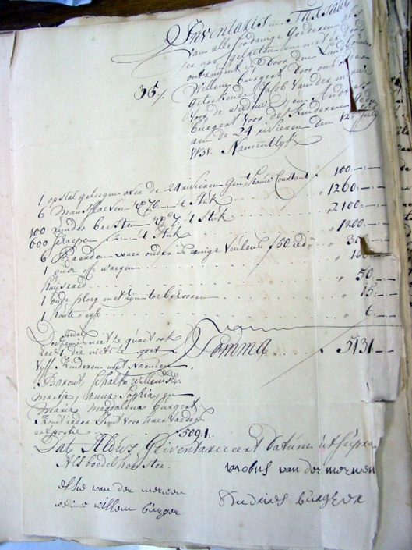
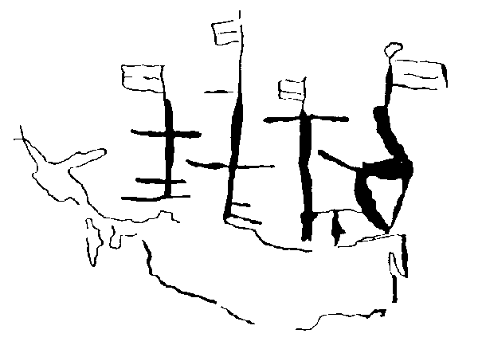
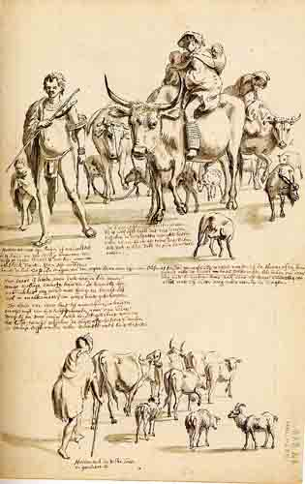
3 goals for today’s lecture
Establish a working definition of history
Outline major strands of South African history
Introduce the principal actors (agents of change) relevant for our story

Slide 6
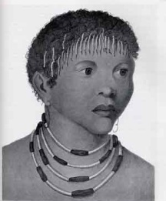
Selected Chronology
+/- 20,000 ybp San (Bushmen) present in Southern Africa
+/- 2,000 ybp Herders (Khoe or “Hottentots”) present at the Cape
1488 Bartolomeu Dias reaches the Cape of Good Hope
1498 Da Gama rounds the Cape
1652 VOC Refreshment Station established
1657 1st 9 Burghers released from Company service
1658 1st major slave imports
1659 1st Dutch-Khoekhoe War
1673-77 2nd Dutch-Khoekhoe War
1686 Stellenbosch (second settler town) established
1688 Huguenots arrive from France
1713 Small pox epidemic
1739 "Northern" Frontier War
1795 Collapse of the VOC
1799 London Missionary Society
1806 Britain asserts full colonial authority at the Cape
1809 Caledon Code
1826 Office of “Protector of the Slaves” established
1828 Ordinance 50 regulates Khoesan indentured labor
1834-38 Emancipation of the Slaves
1855 Wilhelm Bleek arrives in Natal to work on Zulu grammar
1867 Diamond discovieres in Kimberly
1870 Bleek & Lucy Lloyd begin Breakwater Prison interviews
1886 Gold discoveries on the Witwatersrand
1899-1902 South African War
1910 South Africa’s “Declaration of Union”
1911 Bleek & Lloyd, Specimens of Bushman Folklore
1913 Land Act

Slide 7
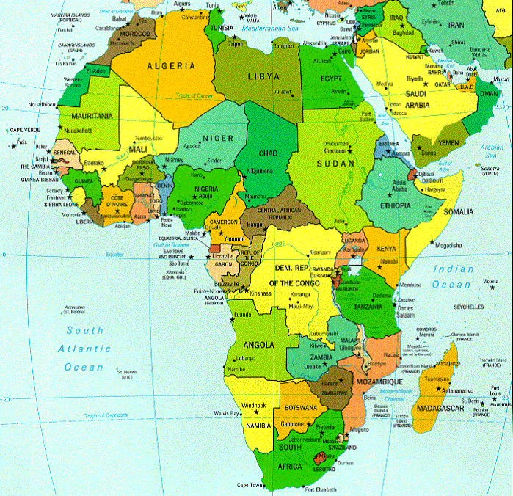
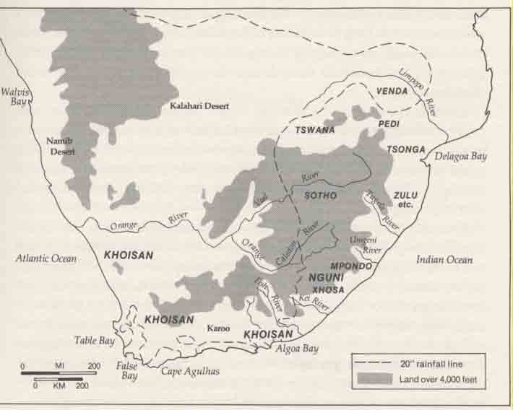
Situating South Africa

Slide 8
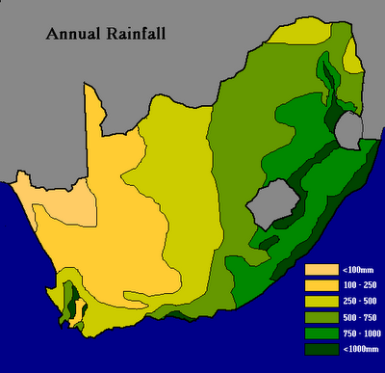
Diverse Climates
Desert
Semi-arid
Sub-tropical and tropical zones
Warm summer rain in the east
Wet, cold rain in the Western Cape (Mediterranean climate)

Slide 9
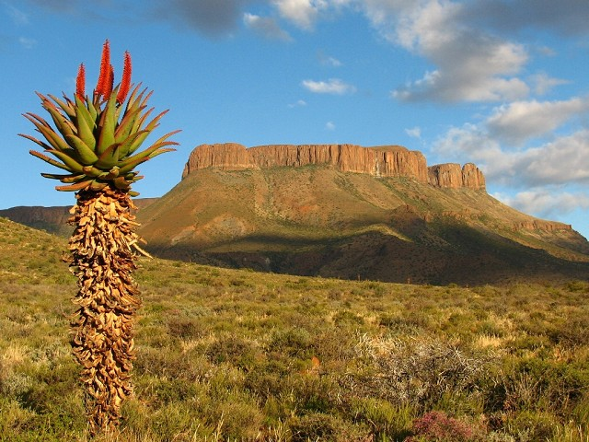
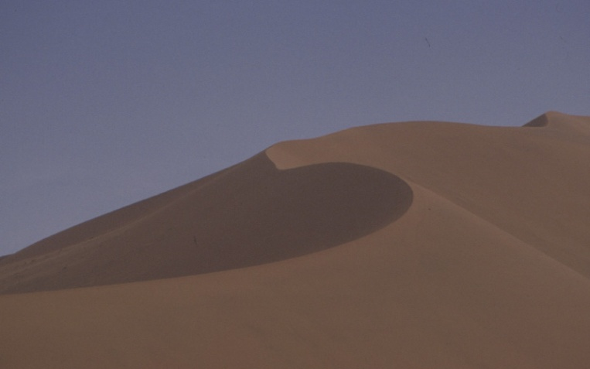
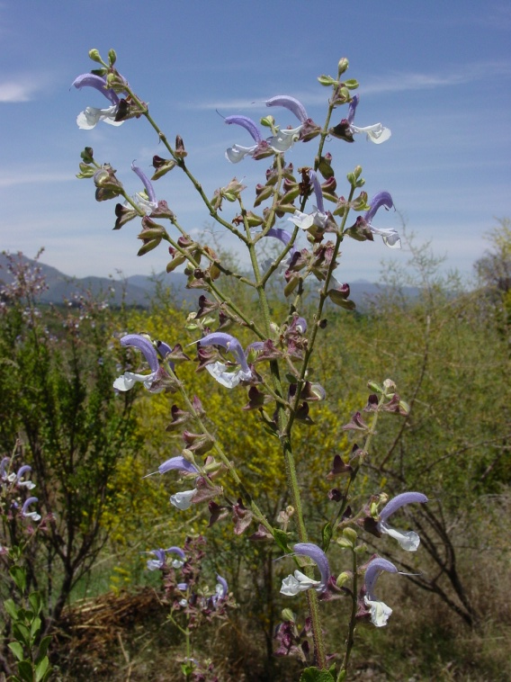
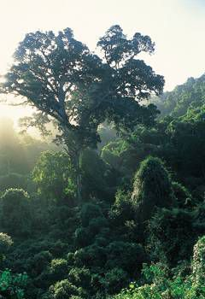
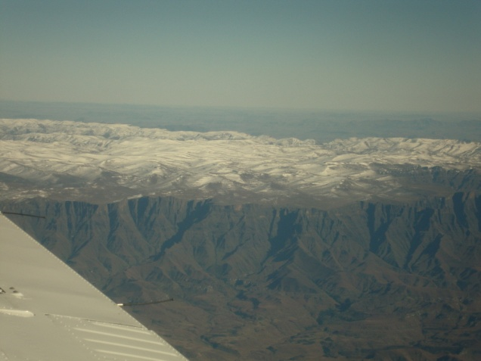
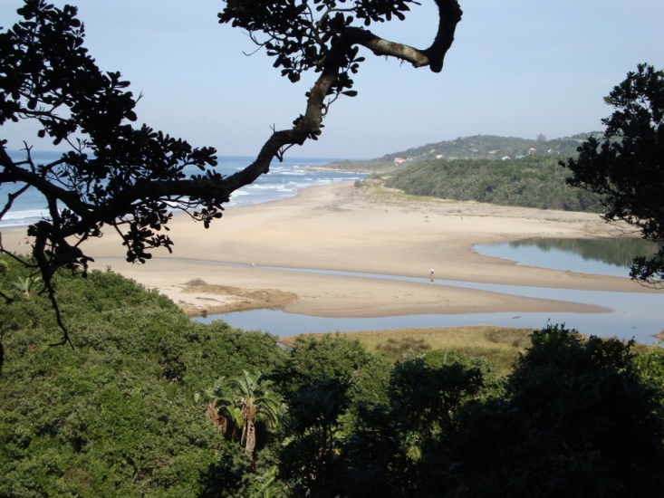
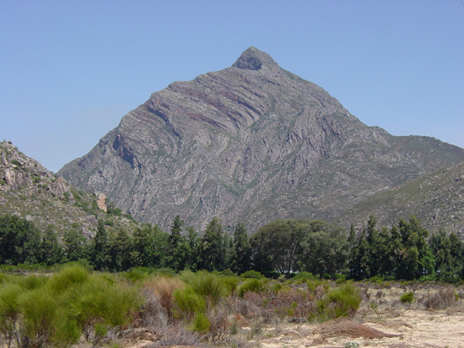
Diverse Ecologies

Slide 10
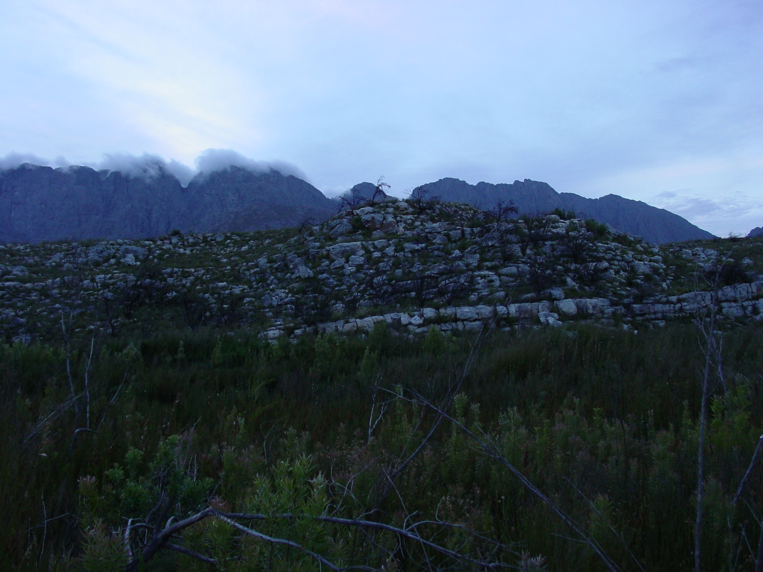
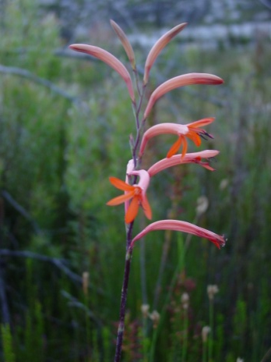
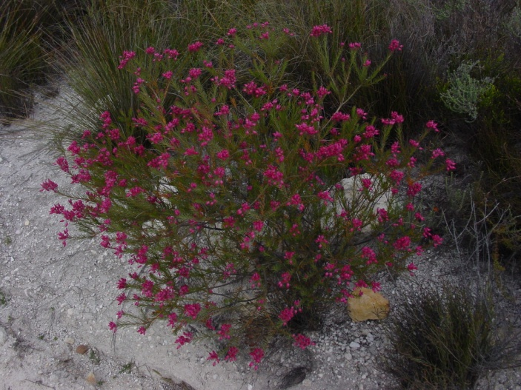
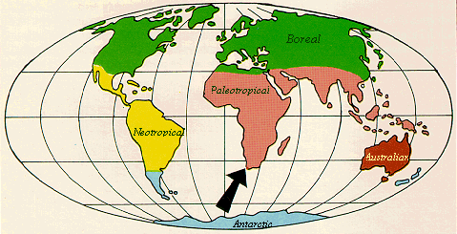
Cape Floral Kingdom
UNESCO World Heritage Site
Fynbos
Notes:
Smallest of the worlds 6 floral kingdoms, but intense species diversity
Less than .5% of the area of Africa, but home to almost 20% of the continent’s flora
High ratio of species to genus (9:1)
World’s highest levels of endemisim (31.9%). Endemic: unique to a defined geographical location—so almost a third of the plants that grow at the Cape occur naturally no where else in the world.
Long before western botanists could present these statistics, they were deeply interested in the place and the plants growing here, which they encountered no where else.

Slide 11
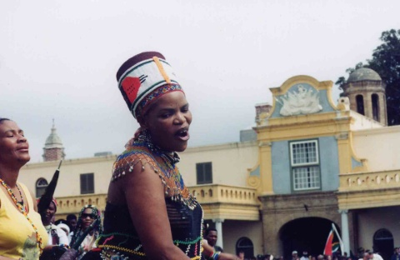
Peopling Southern Africa
Many sites of early human evolution
  Australopithacene fossils at least 2.6 million years old at Sterkfontein
  2010 announcement: new hominid discovery in South Africa
Hunting and foraging peoples in the Western Cape at least 20,000 years ago
Pastoralists at the Cape at least 2,000 years ago
Bantu-speaking farmers south of the Limpopo River by 300 C.E.

Slide 12
Peopleing Southern Africa
San: at least 20,000 ybp
Khoikhoi: about 2,000 ybp
Bantu-speaking farmers by about 300 C.E.

Slide 13
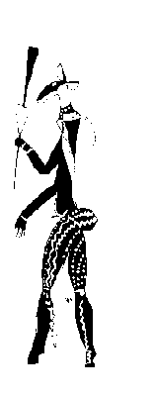
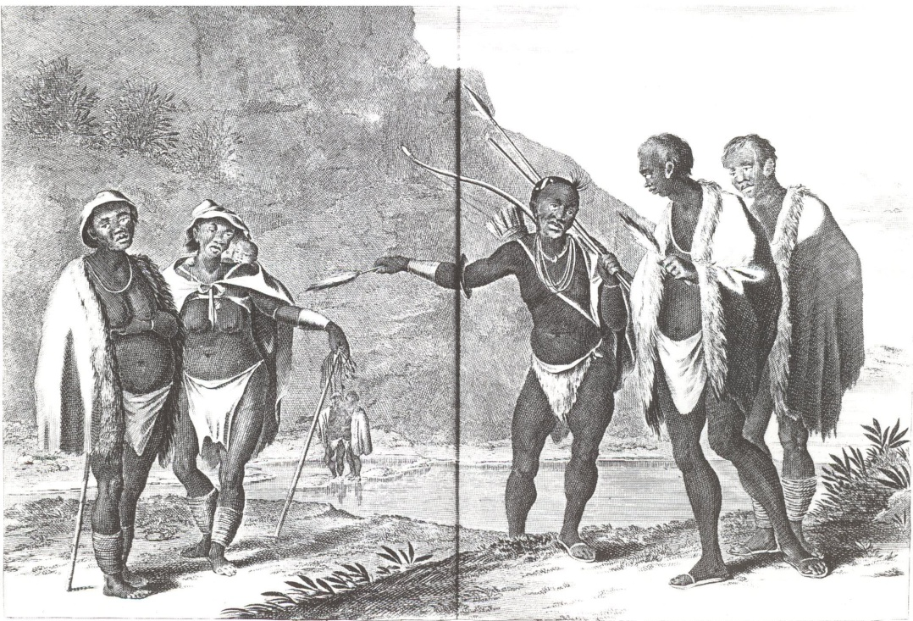
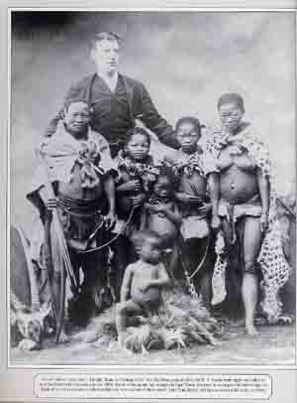

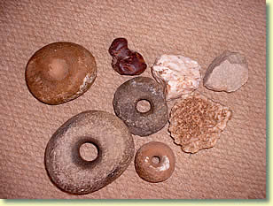
Understanding Khoisan History
Possible Sources
European descriptions
Language Evidence
Rock Art
Material culture remains
Colonial records
19th century
ethnography
O. Dapper, Description de l’Afrique, Amsterdam, 1686
Notes:
O. Dapper, Description de l’Afrique, Amsterdam, 1686
Anonymous, paper dates between 1688 to 1707

Slide 14
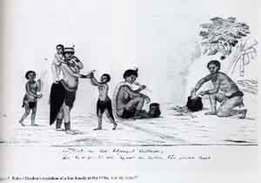
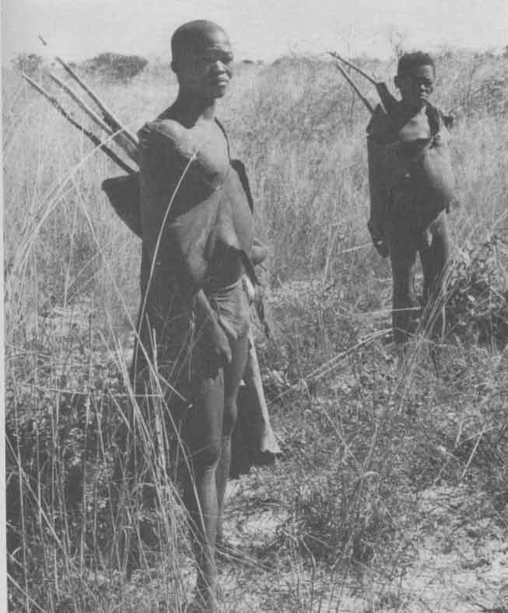
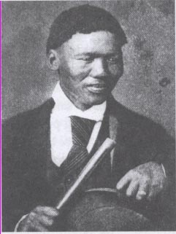
Problematizing “Bushmen”

Slide 15

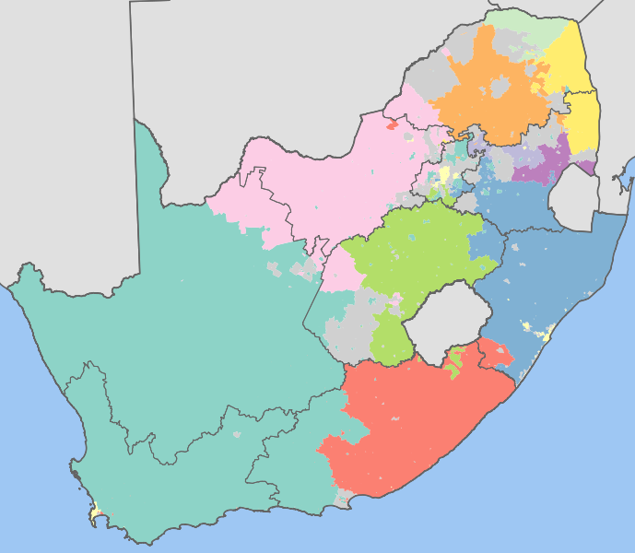
Complicating Colonial Categories
11 Official Languages
Significant history of migration and cultural interactions
Zulu
Xhosa
Afrikaans
Northern Sotho
Tswana
English
Sotho
Tsonga
Swati
Venda
Ndebele
SA Language Map: dominant language
Detailed key

Slide 16
The Inescapable Lens of Apartheid

Slide 17
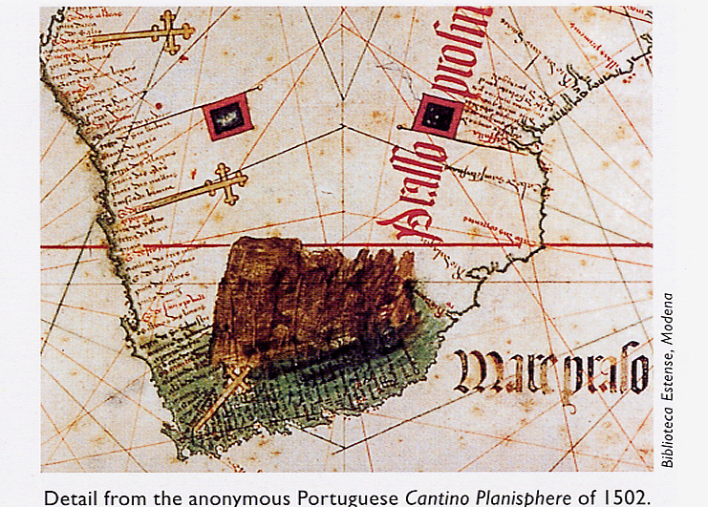
Portuguese Exploration
Portuguese navigators reach the Azores, 1427
Vasco Da Gama, 1498
Bartolomeu Dias, 1488

Slide 18
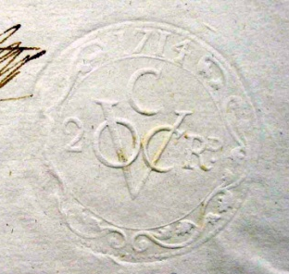
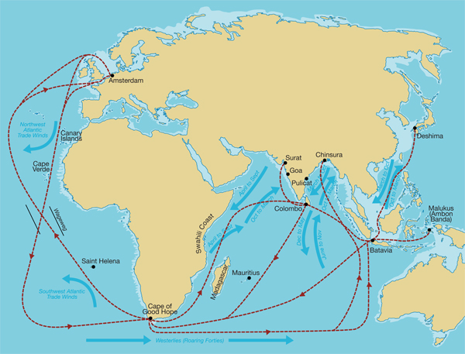
Dutch East India Company
Vereenigde Oost-Indische Compagnie
1602
1619
1652

Slide 19
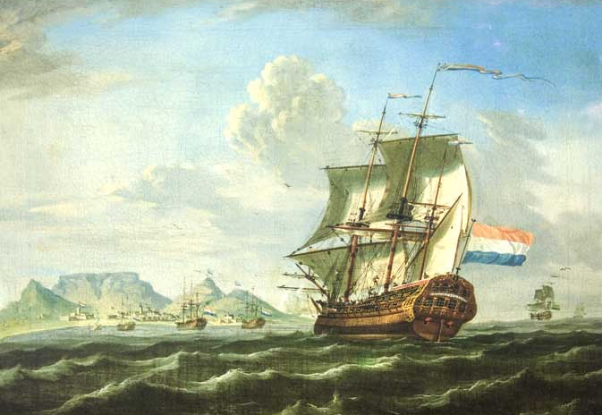
The Tavern of Two Seas

Slide 20
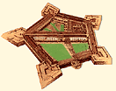
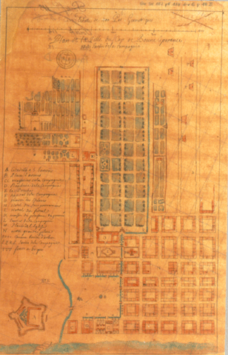
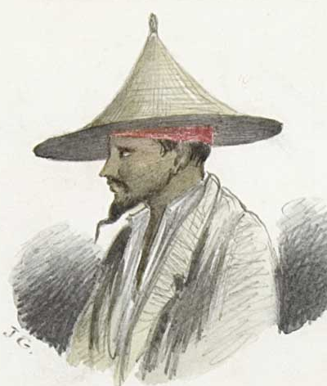
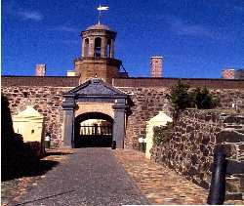
Processes of Colonization
Jan van Riebeeck, 1652
First slaves imported, 1656
First Khoi-Dutch war, 1659
Castle of Good Hope, 1666-79

Slide 21
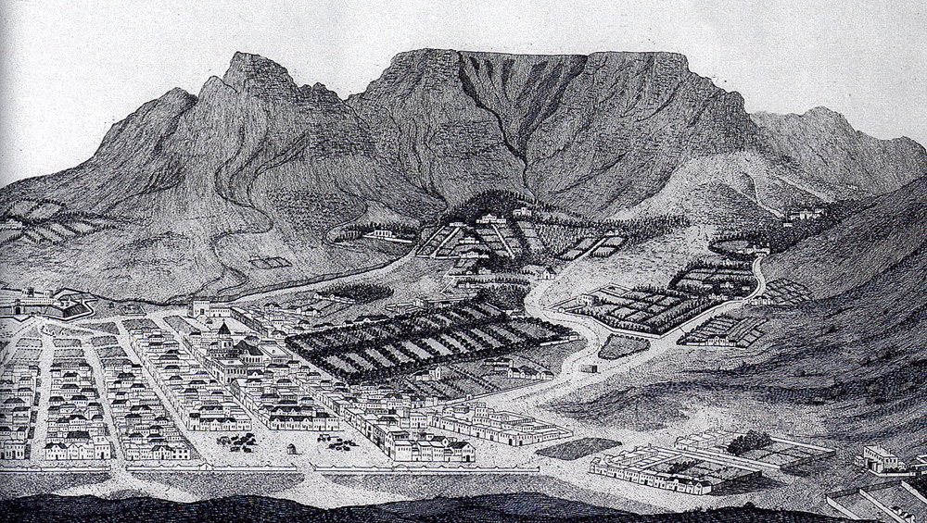
Colonial Settlement at Table Bay
Gezicht van de Kaap der Goede-Hope, van het westen.
Johannes Schumacher (German) 1763.

Slide 22
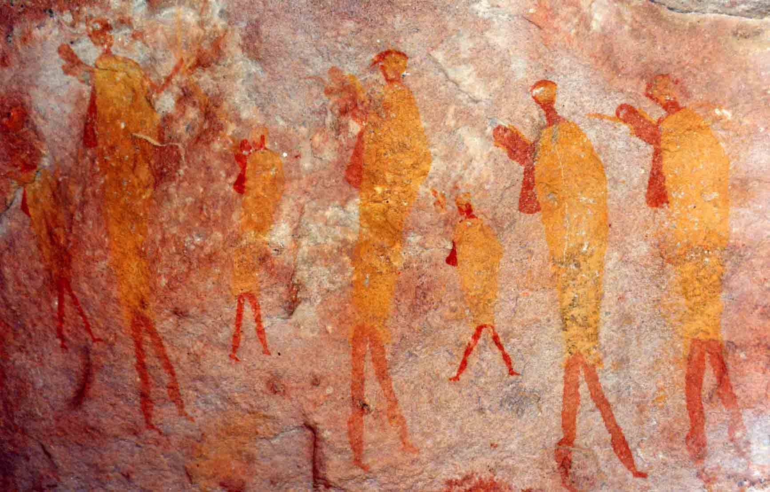
When does South African History begin?

Slide 23
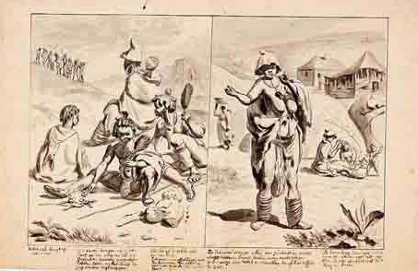
When does South African History begin?

Slide 24
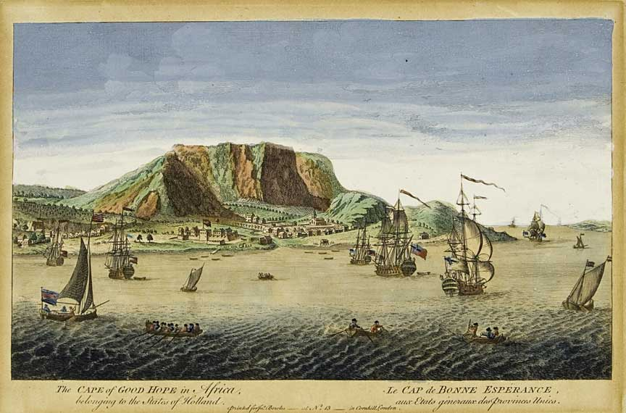
When does South African History begin?

Slide 25




When does South African History begin?

Slide 26

When does South African History begin?

